Slide 1
LES CLEFS D’OR EDUCATION SYMPOSIUM

Slide 2
EDUCATION COMMITTEE
Members
Anders Ruggiero, Chair
Maurice Dancer
Sheron Empey
Jeanne Mills
Rebecca Hawkins
Siana Iong
Abey Sam

Slide 3
SHARE
#LesClefsdOrEdu #TISOH
www.facebook.com/lesclefsdorintl
www.facebook.com/tisoh
@LesClefsdOrIntl
@TISOH
@lesclefsdor
@TISOH_SCHOOL

Slide 4
WIN
@LesClefsdOrIntl
#LesClefsdOrEdu
Refer to the tent cards on the table in front of you for more information.

Slide 5
EDUCATION
BE A LEADER
COMPETENT
CONFIDENT
COMPASSIONATE

Slide 6
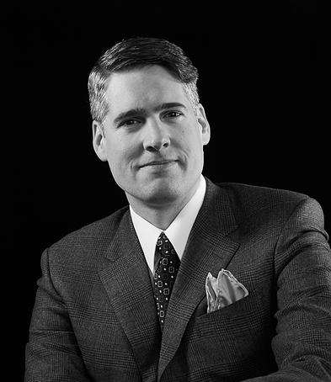
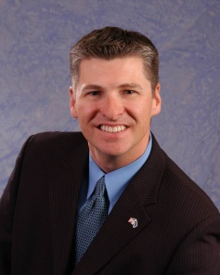
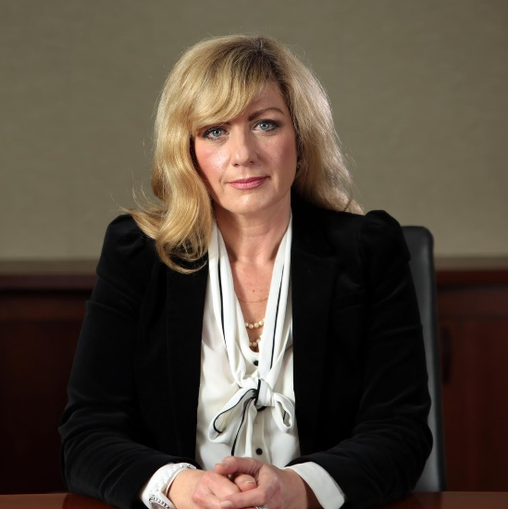
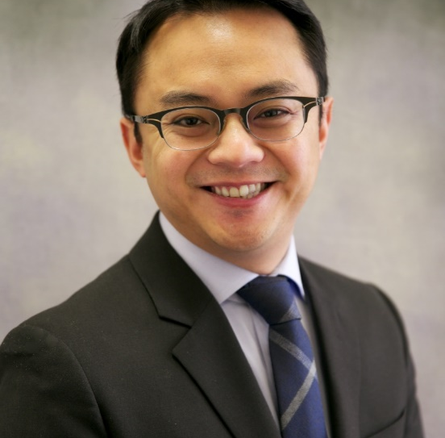
SPEAKERS
TREVOR BOTKIN
Partner & Senior Vice-President Business Design
Think8
JAMES HEALEY
Director of Hotel Operations
New York, New York Hotel & Casino
ALEXANDRA (SASHA) ZILOVIC
Senior Vice-President
ELS Educational Services, Inc.
DR. DONNELL G BAYOT
Director of Academic Affairs
TISOH: The Int’l School of Hospitality

